Slide 1





SCHOOL HOLIDAY
PROGRAM SUMMER 2024

Slide 2
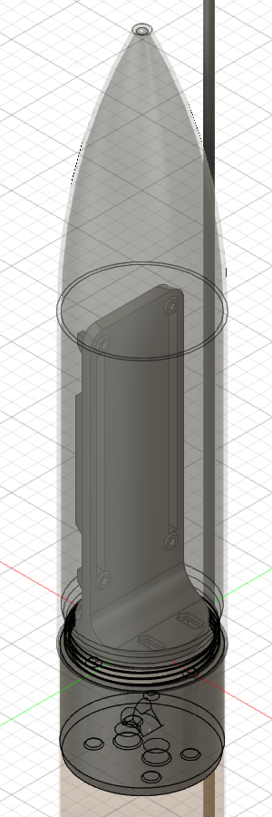
WHAT IS 3D CAD?
3D CAD allows us to:
Create accurate models of designs
Simulate and test prototypes
Communicate the designs in a 3D environment
Notes:
Fergus talk about this one?

Slide 3
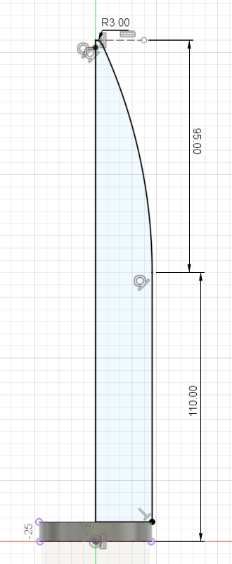
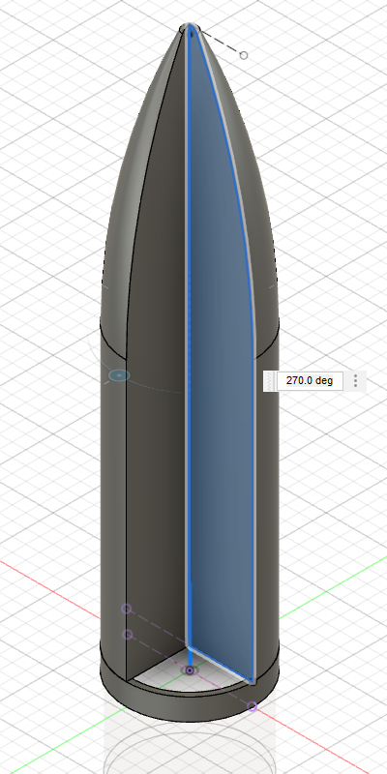
HOW DOES 3D CAD WORK?
The workflow for most 3D CAD programs is:
Create a 2D sketch
Define the sketch fully
Use tools (e.g. extrude, revolve) to create a 3D part from the sketch
Repeat this or add 3D features
Notes:
Fergus talk about this one?

Slide 4
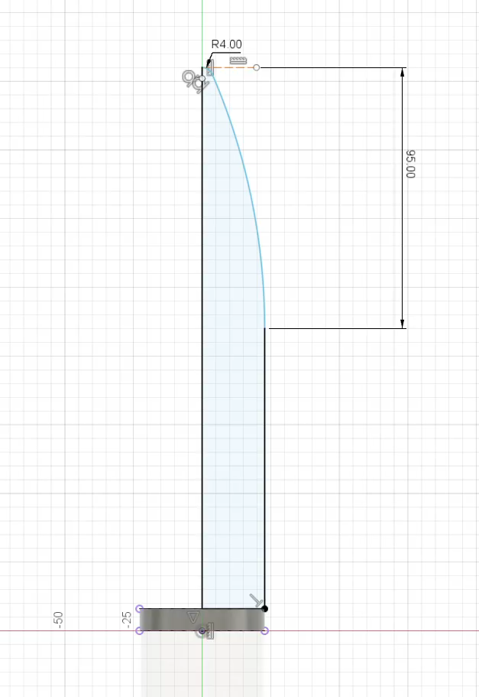
BEST PRACTICES
Fully constrain all sketches
Dimension and constrain to reliable features, e.g. the origin
Use dimensions that reflect the design intent
Notes:
Fergus talk about this one?

